Slide 1
3D Path Planning: Pruning with Constraint Satisfaction (7a)
- Kushagra Khare & Rachit Jain

Slide 2
Introduction
3D path planning is required in various applications such as drones and self-automated robots, self-driving cars, games etc.
Find a trajectory from the initial configuration to the goal configuration, subject to rules of motion and any other constraints, such as collision avoidance and various non-holonomic constraints.

Slide 3
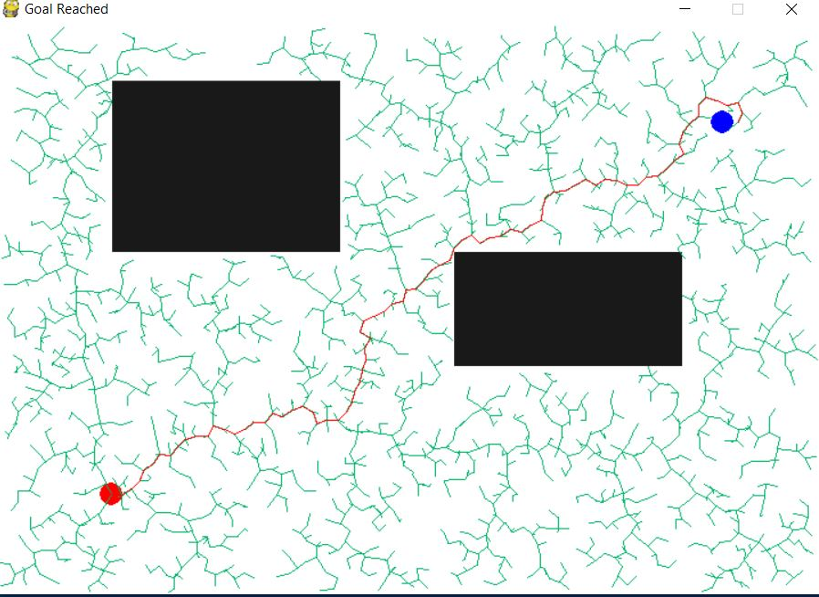
Rapidly-exploring Random Trees (RRT)
Search a space by randomly building a space-filling tree.
The tree is constructed by randomly selecting samples and biased to grow in large unsearched areas.

Slide 4
Limitations
Time consuming
Results in non-optimal paths
Jagged Path
Need of efficient nearest neighbour technique

Slide 5
RRT-A*
A* algorithm is a graph traversal algorithm, i.e. it gives a path between 2 nodes.
A* uses heuristics to guide its search which makes it better than Dijkstra's algorithm.
The cost function of A* is used to determine selection of nodes in the RRT algorithm.

Slide 6
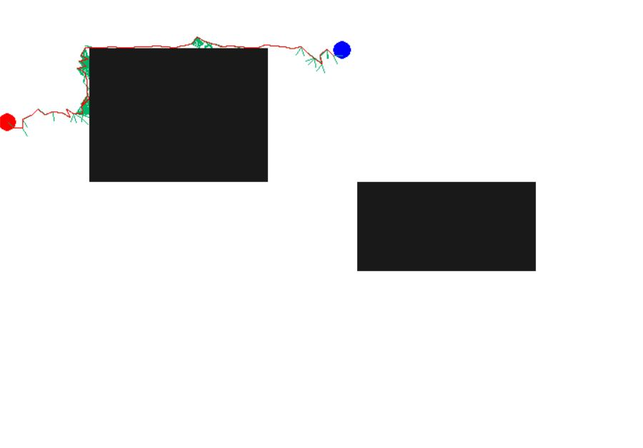
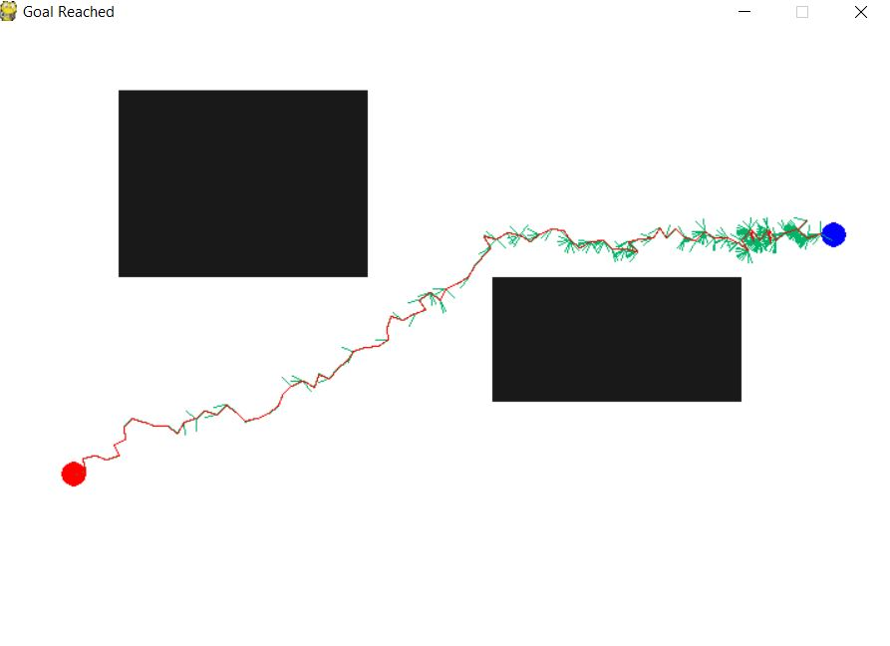
RRT-A*

Slide 7
Limitations
Results in non-optimal paths
Jagged Path
Need of efficient nearest neighbour technique

Slide 8
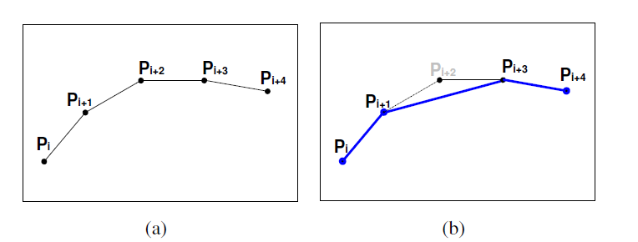
Node Pruning

Slide 9
Limitations
Results in sub-optimal paths
Jagged Path
Need of efficient nearest neighbour technique

Slide 10
RRT*
Extension of RRT algorithm which converges towards optimum solution
It connects the new vertex, X_new, to the vertex that incurs the minimum accumulated cost up until X_new.
RRT* may also extends the new vertex to the vertices in X_near in order to “rewire” the vertices that can be accessed through X_new with smaller cost.
Notes:
Robotic cars spend no more than a few seconds to plan a path before driving toward the goal, which may take several minutes. In such settings, asymptotic optimality is particularly useful, since the available computation time as the robot is moving along its trajectory can be used to improve the quality of the remaining portion of the planned path

Slide 11
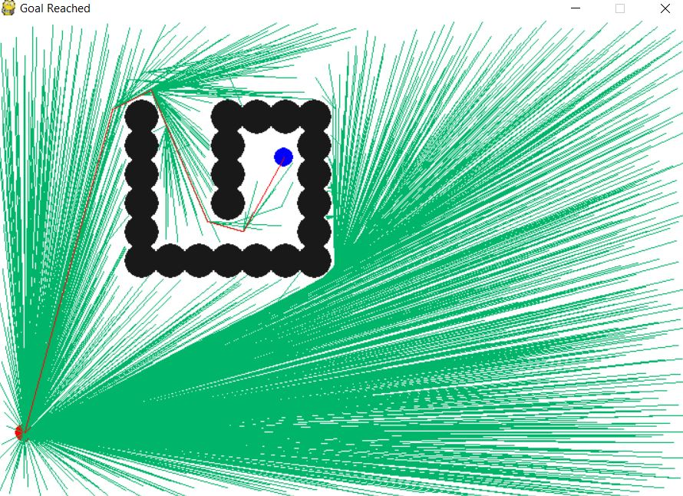

Slide 12
Limitations
Jagged Path
Need of efficient nearest neighbour technique

Slide 13
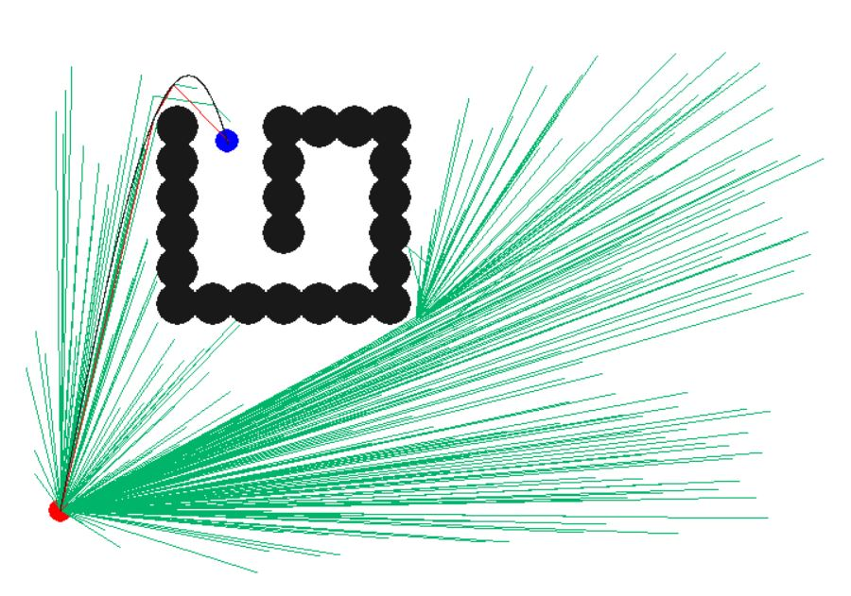
Spline Fitting in RRT*
RRT* produces jagged paths
Impossible for drones, cars etc. to follow.
Paths are smoothened using splines.

Slide 14
Limitations
Need of efficient nearest neighbour technique

Slide 15
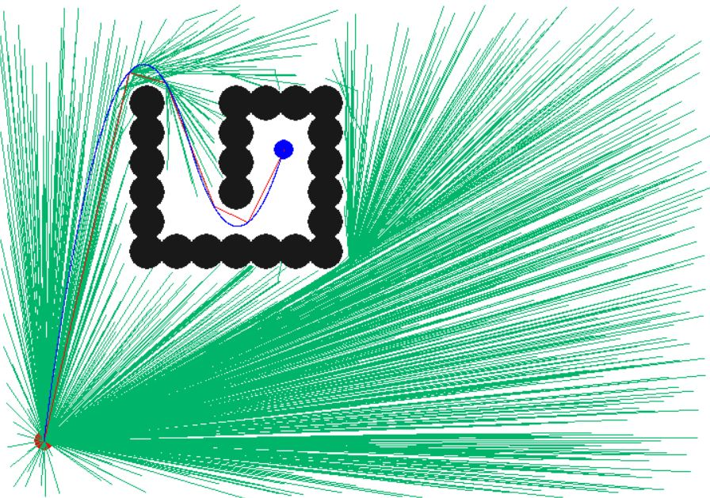
Two Phase sampling with RRT*
If a collision free path satisfying various constraints exists between frontier of the tree and the goal point, then a direct connection is made.

Slide 16
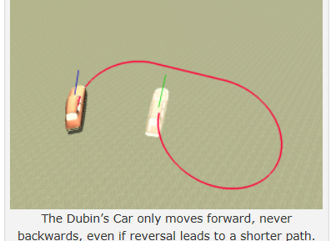
Dubins Path Planning
Dubins car can only move forward, and it always moves at a unit velocity.
Shortest curve between two points with a constraint on the curvature of the path and with prescribed initial and terminal tangents to the path.

Slide 17
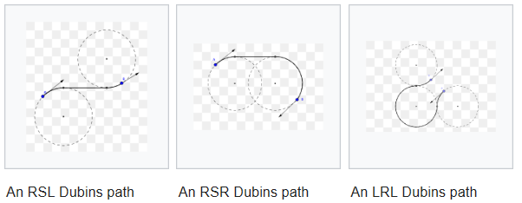
Dubins Path Planning
6 combinations of controls that describe ALL the shortest paths, and they are: RSR, LSL,RSL, LSR, RLR, and LRL.

Slide 18
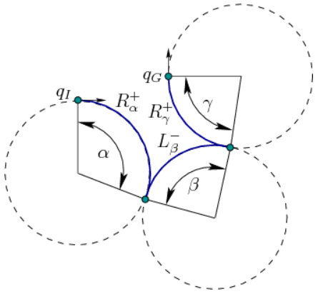
Reeds-Shepp Path Planning
Similar to Dubins path with an additional movement control of moving back

Slide 19
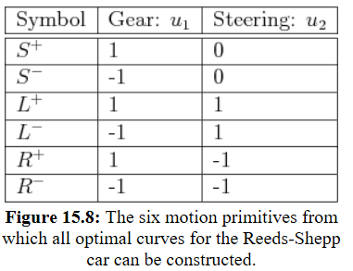
Redds-Shepp
There are 48 different combinations of these controls that describe ALL the shortest paths.

Slide 20
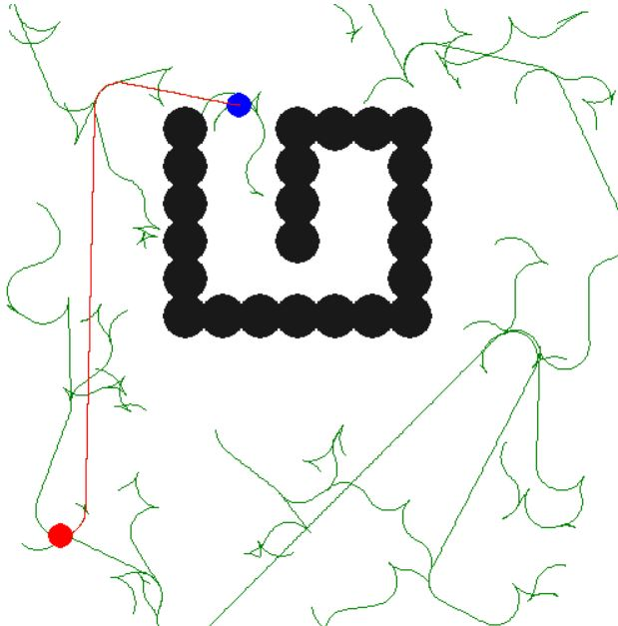
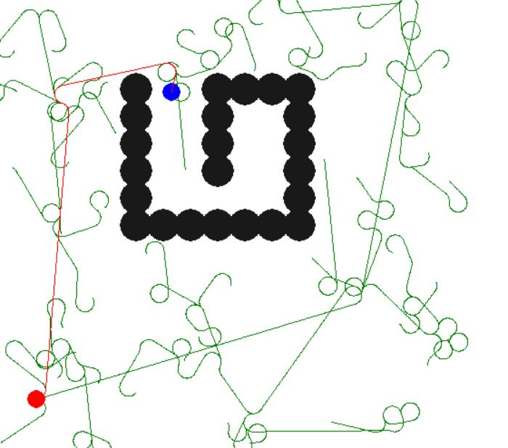
RRT* Dubins & RRT* Reeds-Shepp
Combine Dubins(or Reeds-Shepp) with RRT* to get the desired results, i.e, a path satisfying all non-holonomic constraints.

Slide 21
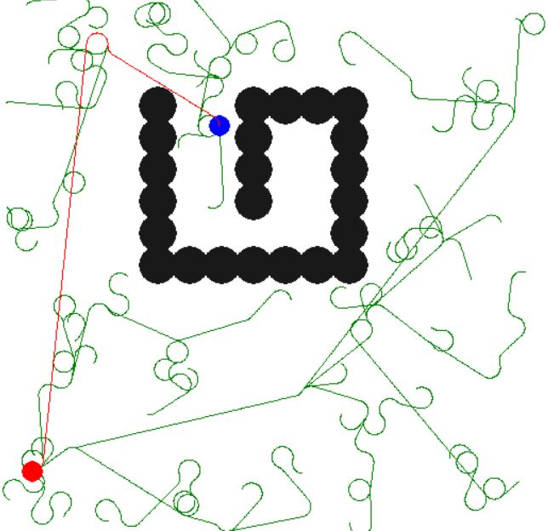
RRT* Dubins

Slide 22
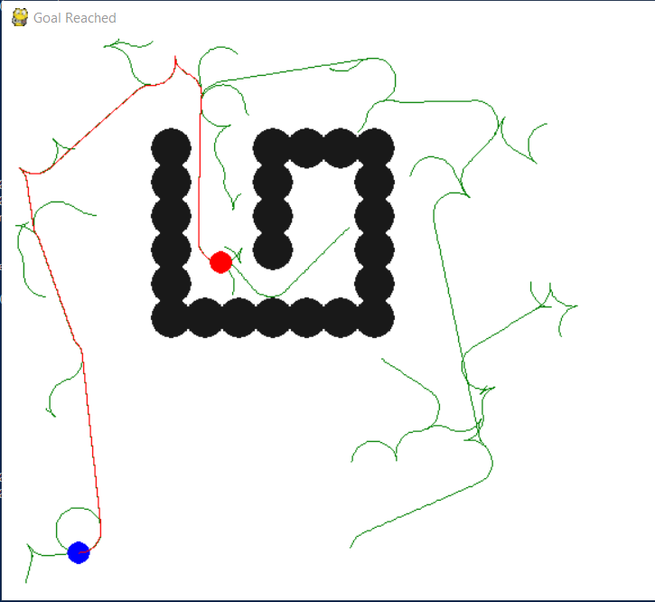
RRT* Reeds-Shepp

Slide 23
Thank You

Slide 24
References
Steven M. LaValle (1998). Rapidly-Exploring Randm Trees: A new tool for Path Planning. http://msl.cs.illinois.edu/ lavalle/papers/Lav98c.pdf
Dubins Path https://gieseanw.wordpress.com/2012/10/21/a-comprehensive-step-by-step-tutorial-to-computing-dubins-paths/
J. A. Reeds AND L. A. Shepp. Optimal paths for a car that goes both forwards and backwards. https://pdfs.semanticscholar.org/932e/c495b1d0018fd59dee12a0bf74434fac7af4.pdf
Jane Li. Non-holonomic Planning http://users.wpi.edu/zli11/teaching/rbe5502017=slides=9%Non-holonomic%20Planning:pdf
Yang et al. (2013). Spline-Based RRT Path Planner for Non-Holonomic Robots, https://link.springer.com/content/pdf/10.1007/s10846-013-9963-y.pdf.

